Slide 1
Coursework: Creating a Data Story
Tom Blount
Heather Packer

Slide 2
Create a Data Story
Imagine you are a freelance investigative journalist. You want to write an article about a topic with a new twist something that grabs an editor's attention, and is backed up by external sources.
It’s your job to tell the public your story bridging the gap between the data in your sources and how it backs up your article’s story.

Slide 3
It's about the story
There’s more to data visualisation than graphs - you need to tell a story
Try to understand what happened and what evidence needs to be collected.
The text describes your findings.
The visualisation supports the story.
The focus is the story.

Slide 4
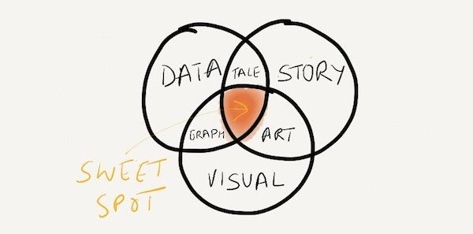
Data Story Visual

Slide 5
Deadlines and Marks
1st Deadline, Week 7: Outline, Data Diary, and Data Sources
2nd Deadline, Week 15: Data Story and Report
Coursework 100% of the marks available for this module

Slide 6
Submission
Week 7:
Overview PDF; outline of your data story, outlining the topic, wireframes and justifications
Data Sources PDF; descriptions of the data you’re using, based on the provided template
(Plus completed the “data diary”)
Week 15:
A zip file containing
HTML file
Three embedded visualisations (charts, tables and other graphics)
appropriate supporting text
CSS file
Instructions PDF
Report PDF

Slide 7
Topics
Trends in university enrollment; what are the causes and consequences?
How did “Fake News” affect the 2016 US Election?
Trends in global life-expectancy; what are the factors and effects?
A different topic of your choice

Slide 8
Data Diary (Week 7)
When searching for your data sources, fill out the provided form: http://bit.ly/2hprP4w
Fill this form out for each query you make
We expect a minimum of 5 searches per person
Recommend you do at least one in the next few days to try it out

Slide 9
Datasources (Week 7)
Once you’ve found your data sources, describe each one in a short paragraph
Take note of the features you should mention: http://bit.ly/2lxwg1F

Slide 10
Overview (Week 7)
500 words (about one page, not including images)
What is your data story?
What data have you acquired?
What tools are you planning to use
What charts do you plan to use to tell your story? Why?
Use wireframes or mockups

Slide 11
You can use
D3
Tableau
Any other tools you deem appropriate
If you choose to use another language then there will not be any support available.

Slide 12
Rules
This coursework is to be completed individually
The usual late penalties apply for late handins
No plagiarism
This means cite your sources

Slide 13
What to put in the report
2500 words (about 5 pages)
Pick out characteristics that are well done, and those than could be improved upon
Discuss why your chosen charts are suitable for what you are presenting
Outline how you would modify the charts to make them even better suited to their task, and how they could tell your story better.
Discuss the concepts covered in the course within your report and use these to justify your chart choices and design.
Cover how each chart:
makes a particular piece of evidence readable by your intended audience
avoids bias or confusion
emphasises the key data,
draws on theories discussed in the course
References; cite any work that you have drawn on

Slide 14
Advice
Incorporate more than one data source
Clear charts/graphics
Follow the principles outlined in the course lectures
Interactivity

Slide 15
Common Simple Mistakes to Avoid
Using 1 type of graph
Labeling of axis
No titles
No compelling narrative
Too much data not enough context
Creating charts using pre-existing templates, especially if these fail to display good design principles as covered in the lectures.

Slide 16
Data Sources (1)
Data.Soton http://data.soton.ac.uk - the university’s open data service
Data.gov http://data.gov The US Government pledged last year to make all government data available freely online.
US Census Bureau http://www.census.gov/data.html A wealth of information on the lives of US citizens covering population data, geographic data and education.
European Union Open Data Portal http://open-data.europa.eu/en/data/ As the above, but based on data from European Union institutions.
Data.gov.uk http://data.gov.uk/ Data from the UK Government, including the British National Bibliography – metadata on all UK books and publications since 1950.
Canada Open Data is a pilot project with many government and geospatial datasets.
Datacatalogs.org offers open government data from US, EU, Canada, CKAN, and more.
The CIA World Factbook https://www.cia.gov/library/publications/the-world-factbook/ Information on history, population, economy, government, infrastructure and military of 267 countries.
Healthdata.gov https://www.healthdata.gov/ 125 years of US healthcare data including claim-level Medicare data, epidemiology and population statistics.
NHS Health and Social Care Information Centre http://www.hscic.gov.uk/home Health data sets from the UK National Health Service.
UNICEF offers statistics on the situation of women and children worldwide.
World Health Organization offers world hunger, health, and disease statistics.
Amazon Web Services public datasets http://aws.amazon.com/datasets Huge resource of public data, including the 1000 Genome Project, an attempt to build the most comprehensive database of human genetic information and NASA ’s database of satellite imagery of Earth.

Slide 17
Data Sources (2)
UCLA makes some of the data from its courses public.
Data Market is a place to check out economics, healthcare, food and agriculture, and car data
Google Public data explorer includes data from world and human development indicators, OECD.
Gapminder http://www.gapminder.org/data/ Compilation of data from sources including the WHO and World Bank covering economic, medical and social statistics from around the world.
Google GOOGL +0.07% Trends http://www.google.com/trends/explore Statistics on search volume (as a proportion of total search) for any given term, since 2004.
Google Finance https://www.google.com/finance 40 years’ worth of stock market data
Google Books Ngrams http://storage.googleapis.com/books/ngrams/books/datasetsv2.html Search and analyze the full text of any of the millions of books digitised as part of the Google Books project.
National Climatic Data Center http://www.ncdc.noaa.gov/data-access/quick-links#loc-clim Huge collection of environmental, meteorological and climate data sets from the US National Climatic Data Center.
DBPedia http://wiki.dbpedia.org
New York Times NYT +1.71% http://developer.nytimes.com/docs Searchable, news articles from 1851.
Freebase http://www.freebase.com/ A community-compiled database of structured data about people, places and things, with over 45 million entries.
Financial Data Finder at OSU offers a large catalog of financial data sets.
Pew Research Center offers its raw data from its fascinating research into American life.

Slide 18
Examples
Let’s look at some example Data Stories
Think about them critically
Don’t just look at the charts/layout
What point do you think each of them are making?

Slide 19
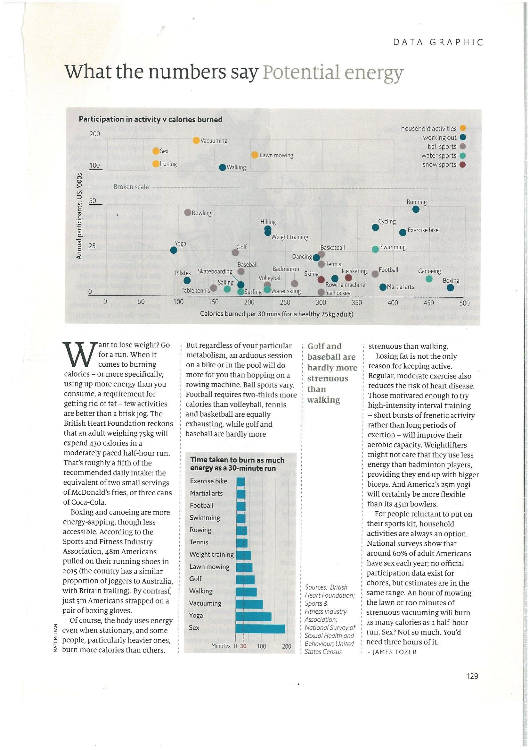
Potential Energy
2 visualisations
Keys, labels and titles
Easy to read
Story contains key facts
Summary sentence `Golf and baseball hardly more strenuous than walking’
More than one source
Lists sources

Slide 20
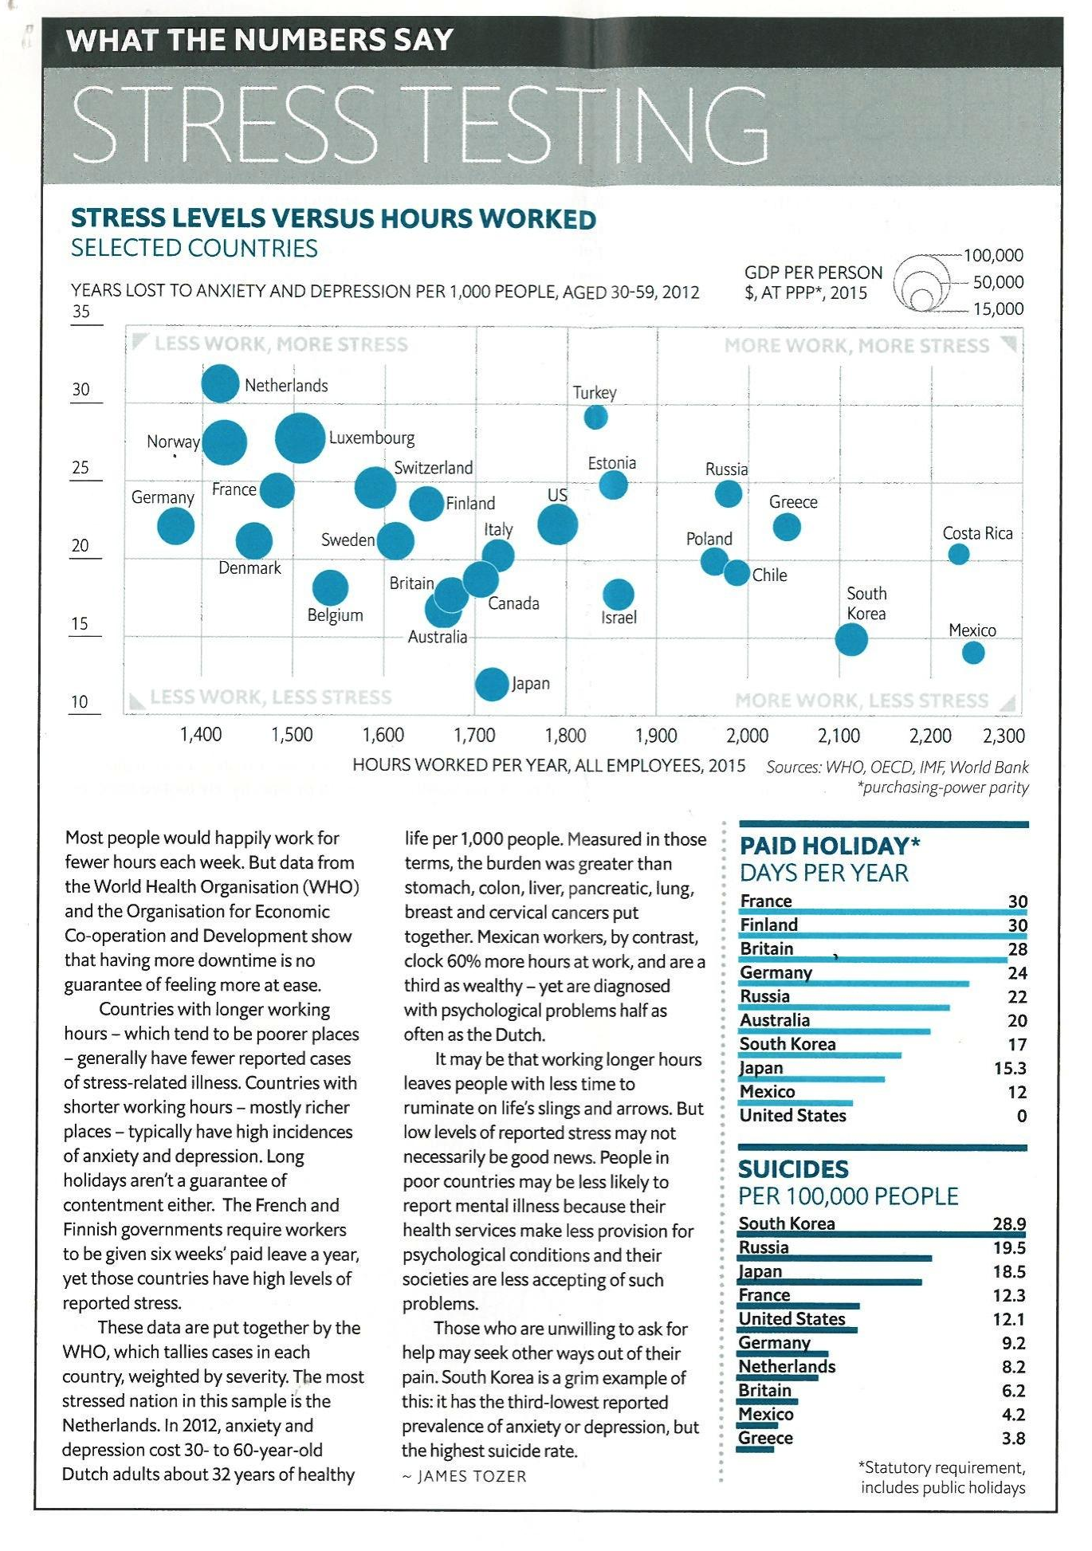
Stress Testing
3 visualisations
Keys, labels and titles
Easy to read
Story contains key facts
More than one source
Lists sources

Slide 21
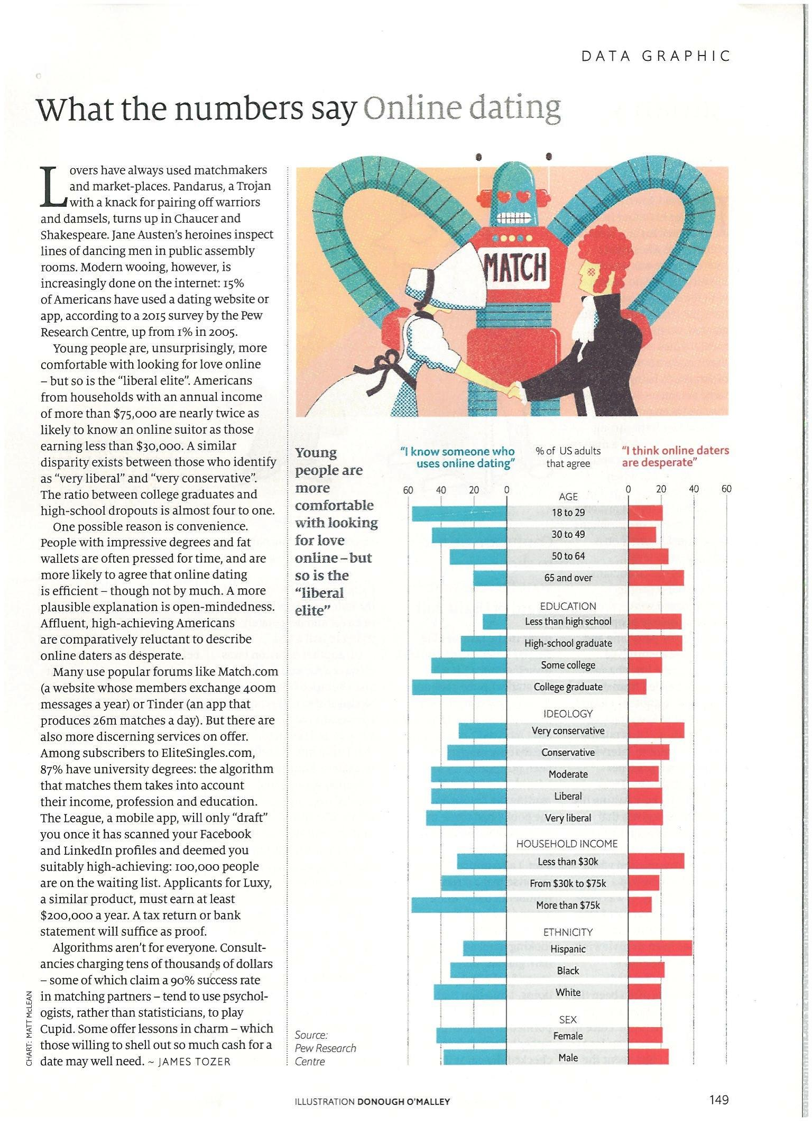
Online Dating
1 visualisation
Keys, labels and titles
Easy to read
Story contains key facts
Summary sentence `Young people are more comfortable with looking for love online …’
Lists source

Slide 22
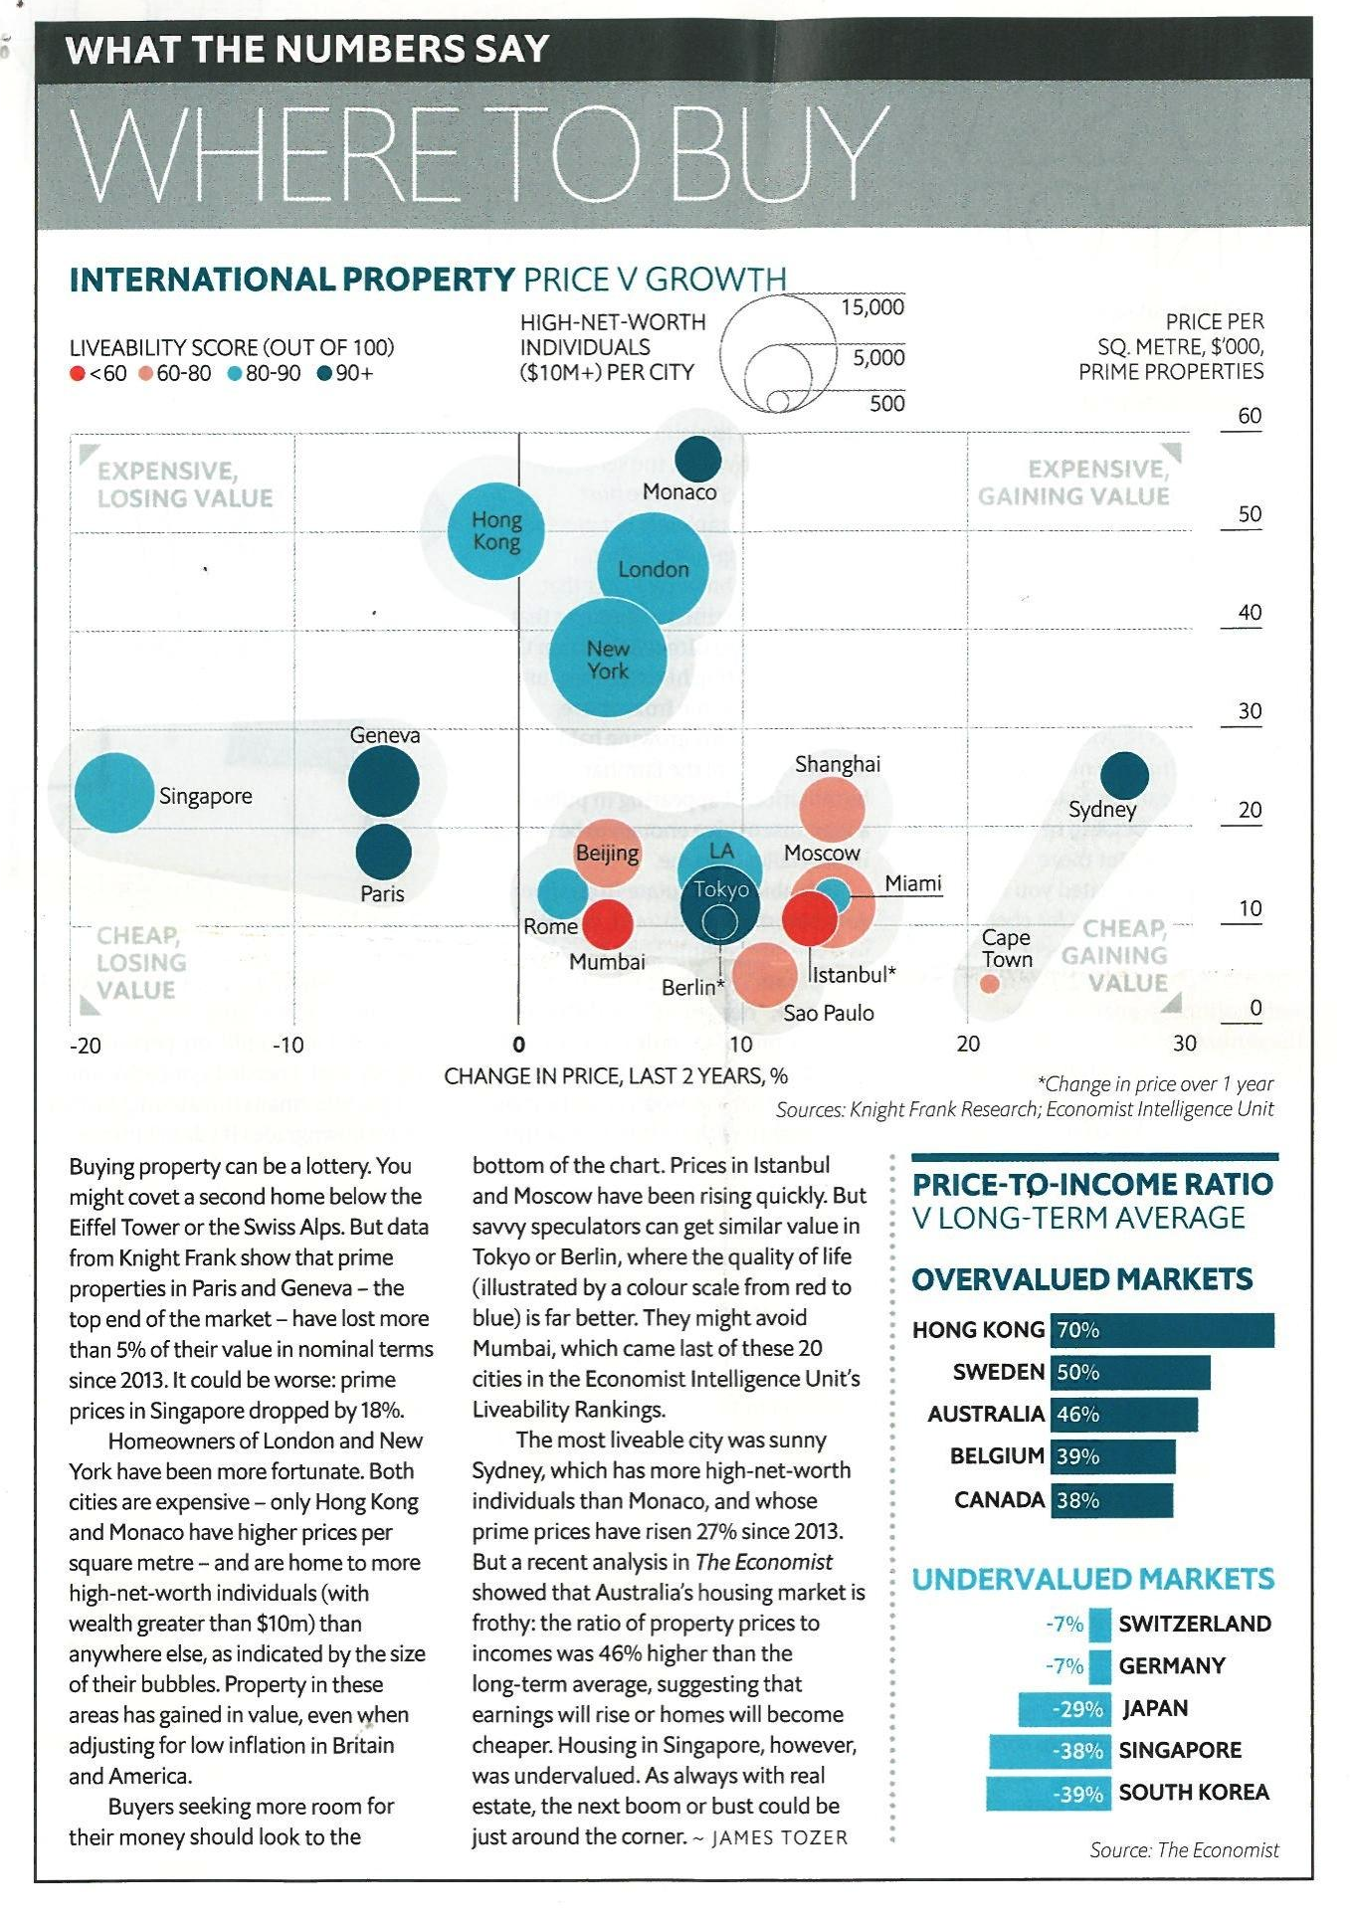
Where to buy
3 visualisations
Keys, labels and titles
Easy to read
Story contains key facts
Lists source

Slide 23
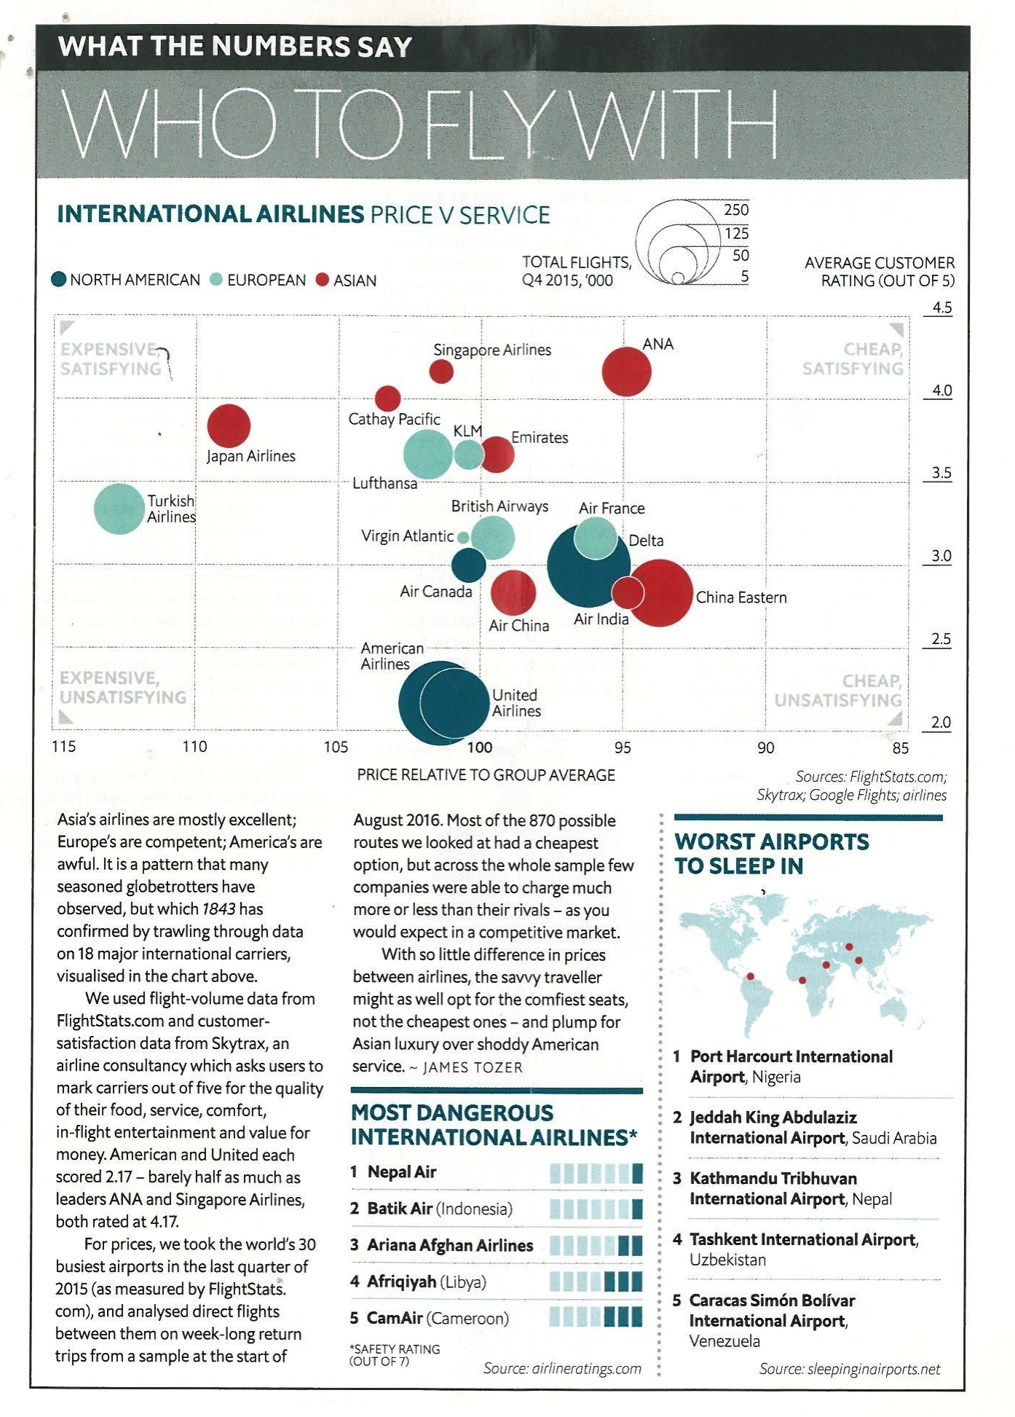
Who to Fly with
3 visualisations
Keys, labels and titles
Easy to read
Story contains key facts
Lists sources

Slide 24
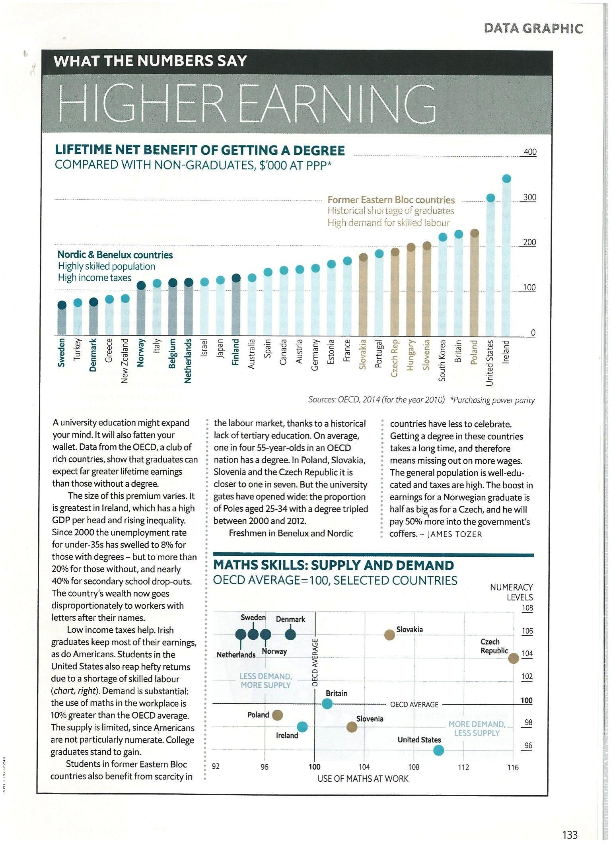
Higher Earning
2 visualisations
Keys, labels and titles
Easy to read
Story contains key facts
Lists sources

Slide 25
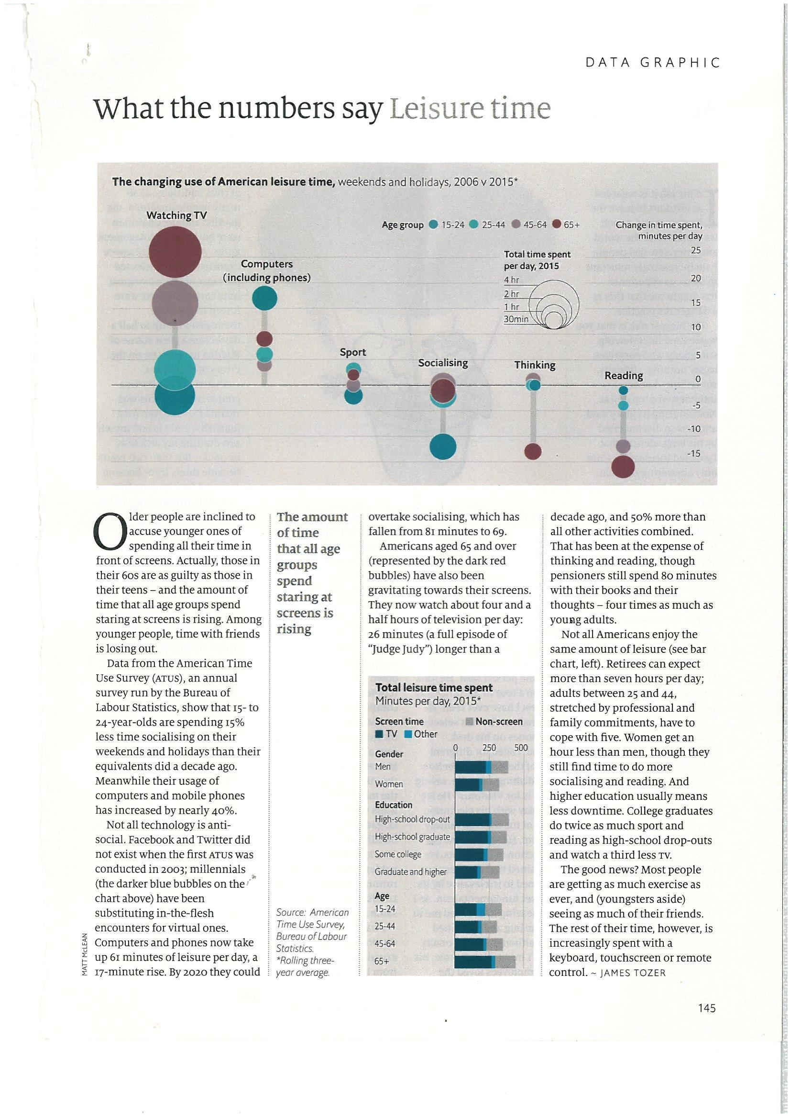
Leisure Time
2 visualisations
Keys, labels and titles
Easy to read
Story contains key facts
Lists sources
Summary sentence `The amount of time that all age groups spend staring at screens is rising’

Slide 26
Common Features
One main visualisation at forefront of article
Supporting images focusing on a specific detail described in story
More than one source
Written in a journalistic tone
Story references numbers and statistics from visualisations

Slide 27
As a journalist think about..
Audience - who is this topic of interest to?
Sources
Is your story newsworthy? Think about its
Proximity to your audience
Prominence (is the subject well known)
Timeliness
Oddity (is it unusual shocking or bizarre)
Consequence
Conflict
Human Interest
Extremes/superlatives
Scandal
Impact
What visualisations back up your story?

Slide 28
Things to consider
Clarity of narrative
Appropriate choice of visualisations
Limit chart junk
Emphasise key data
Appropriate uses of colour
Visualisations titled and captioned
Supporting narrative text
Grammar, spelling & presentation
Clear structure and flow to content
Appropriate use of interactivity

Slide 29
Any questions?
1st Deadline, Week 7: Outline, Data Diary, and Data Sources
2nd Deadline, Week 15: Data Story and Report

